Slide 1
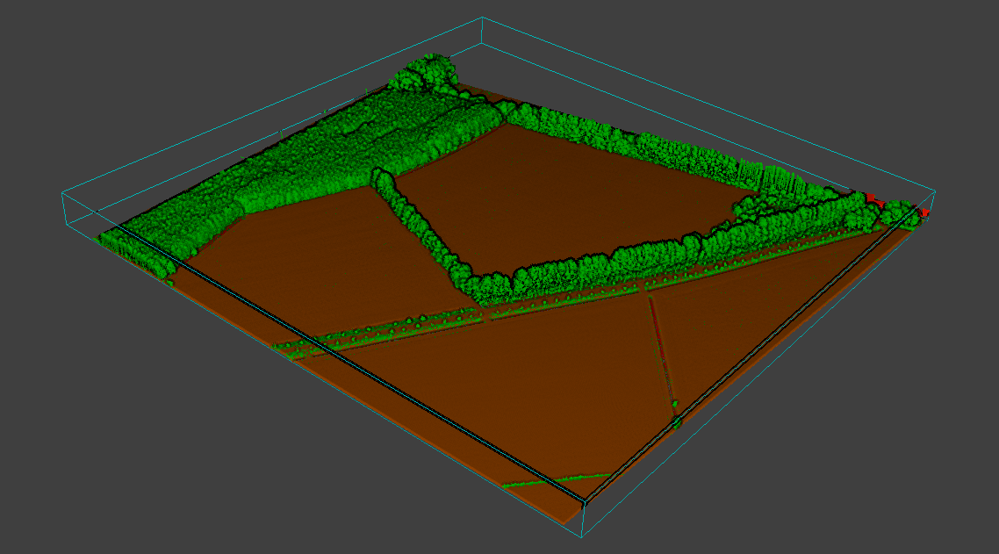
Delineating linear vegetation elements in agricultural landscapes using LiDAR point clouds
Master Thesis -- Chris Lucas
Supervisors:
Dhr. prof. dr. ir. W. Bouten
Dhr. dr. A.C. Seijmonsbergen

Slide 2
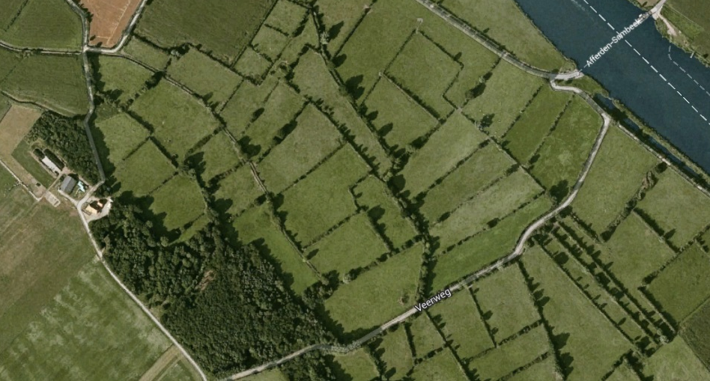
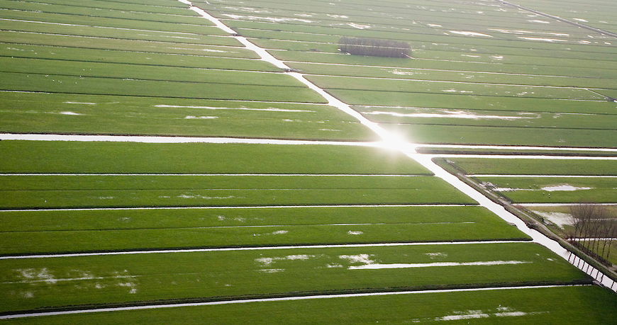
Introduction
Human impact
Mosaic landscape
Linear elements
∙ Roads
∙ Tree lines
∙ Hedges
∙ Water
Corridors & barriers
| Introduction | | Research Area | | Data | | Method | | Results | | Discussion | | Conclusion | | Questions |

Slide 3
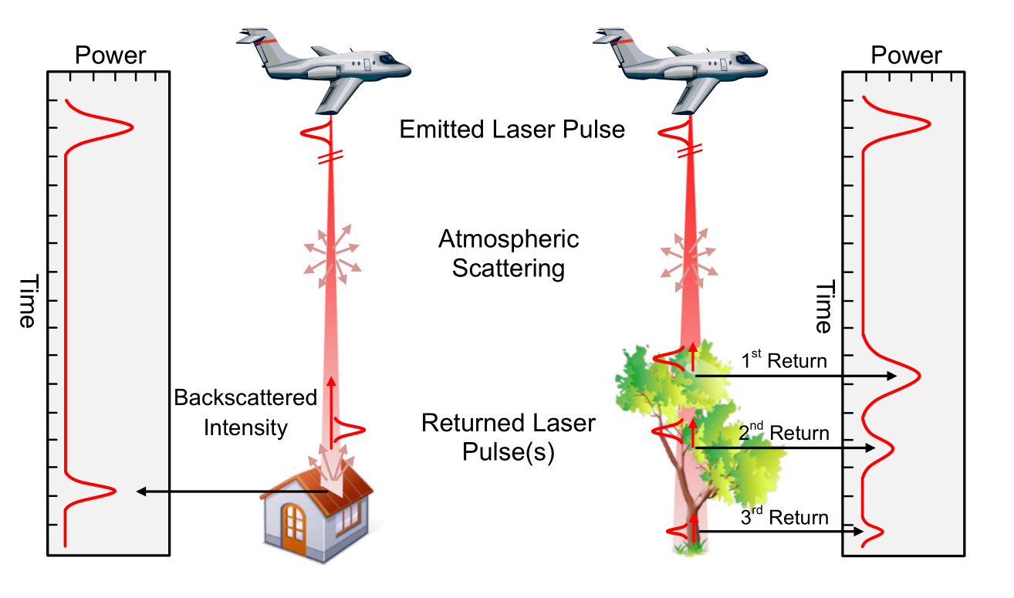
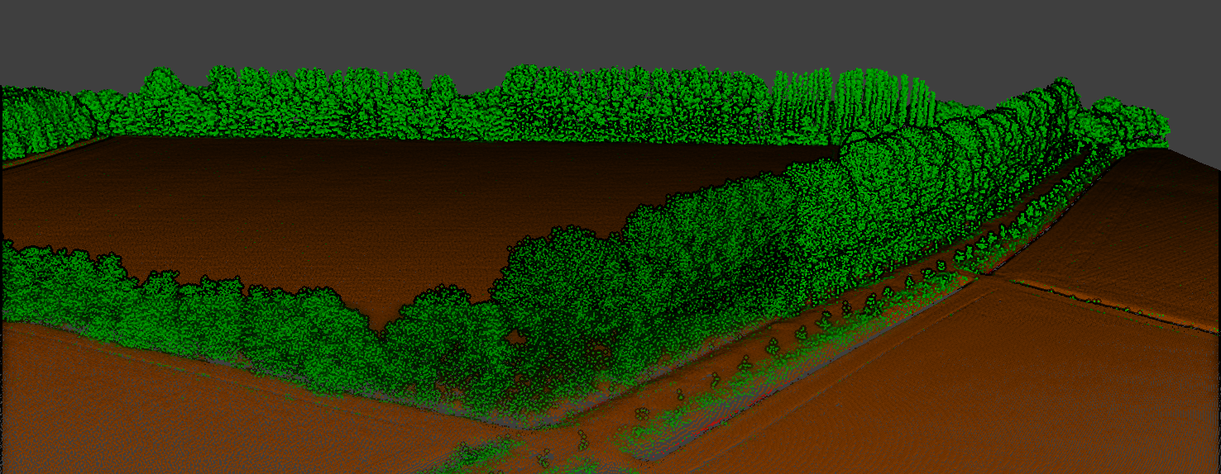
Previous research
∙ Interpolation between ground truth points (Van der Zanden et al., 2013)
Remote Sensing
∙ LiDAR
| Introduction | | Research Area | | Data | | Method | | Results | | Discussion | | Conclusion | | Questions |

Slide 4
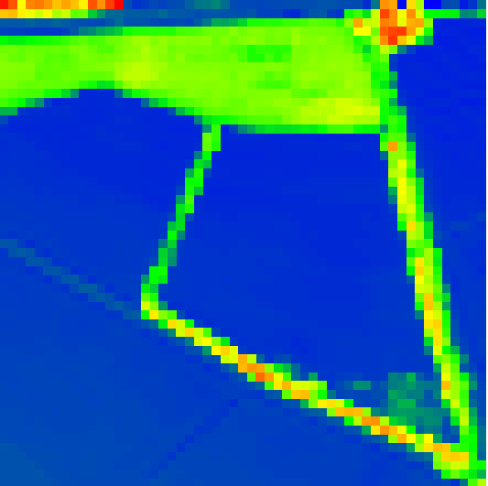
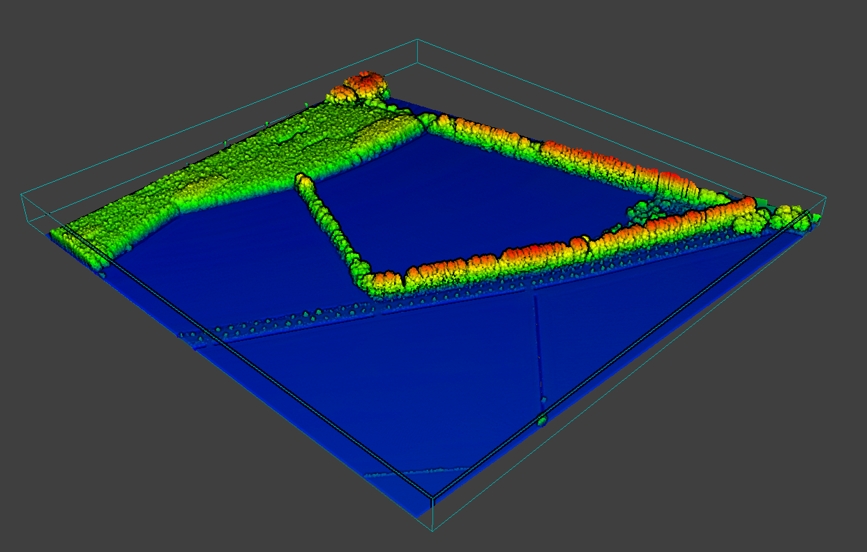
Existing Research - Classification
LiDAR derived rasters or
point cloud based
Machine Learning
∙ Support Vector Machine
∙ Random Forest
∙ Adaboost
∙ And more
| Introduction | | Research Area | | Data | | Method | | Results | | Discussion | | Conclusion | | Questions |

Slide 5
Existing Research – Linear Elements
Identify linear elements
∙ Raster-based
∙ Road Detection
∙ Edge detection
∙ Road Tracking
∙ Road Linking
| Introduction | | Research Area | | Data | | Method | | Results | | Discussion | | Conclusion | | Questions |

Slide 6
Aim:
∙ Develop a method to delineate linear vegetation
elements in LiDAR point clouds
Focus points:
∙ Characteristic LiDAR features of vegetation
∙ Separate linear elements
∙ Accuracy
| Introduction | | Research Area | | Data | | Method | | Results | | Discussion | | Conclusion | | Questions |

Slide 7
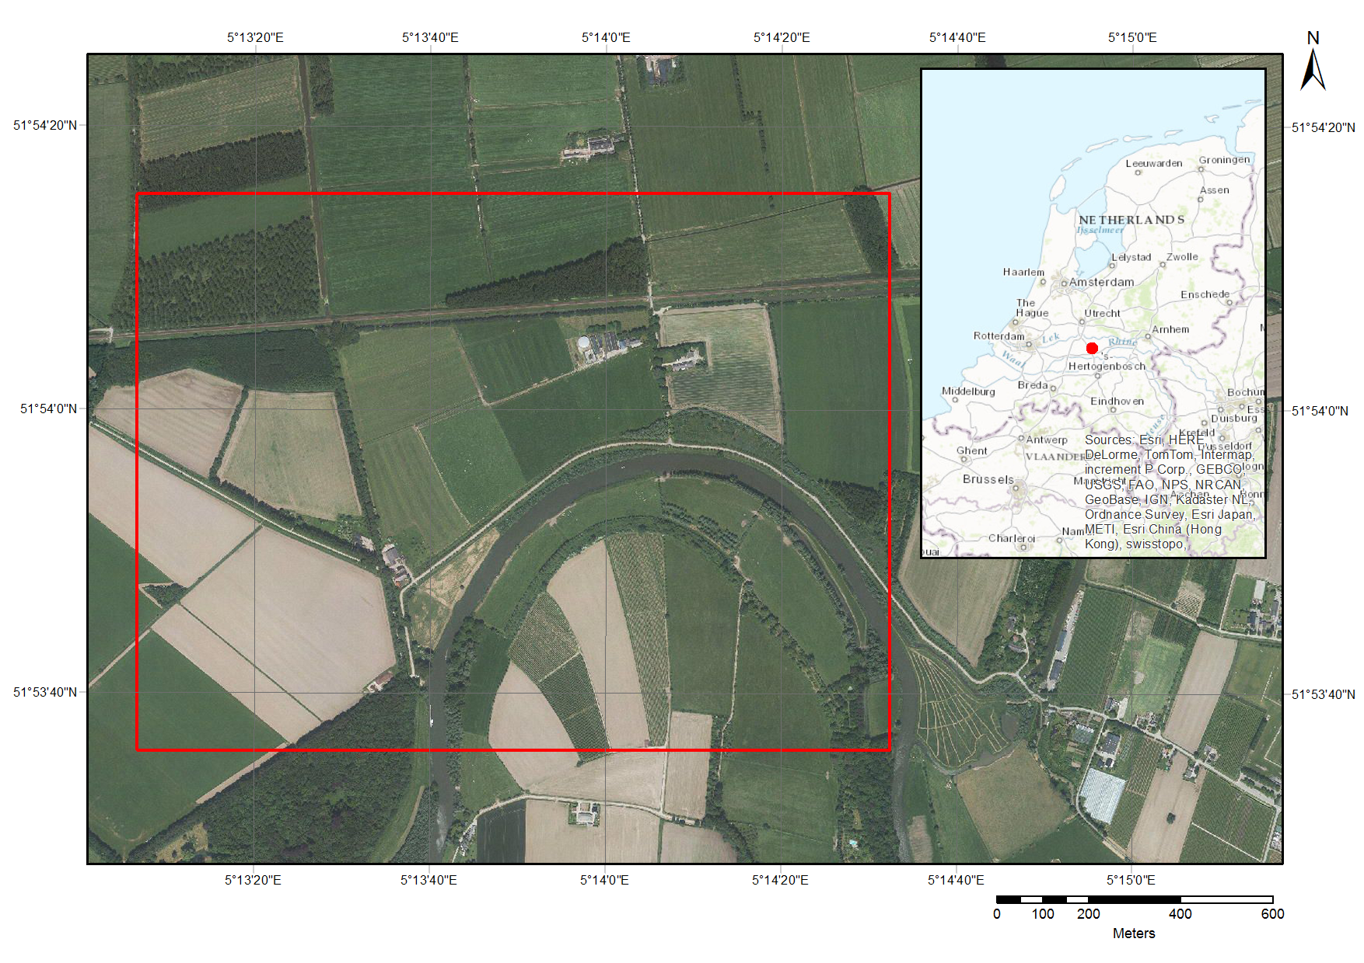
Research Area
| Introduction | | Research Area | | Data | | Method | | Results | | Discussion | | Conclusion | | Questions |

Slide 8
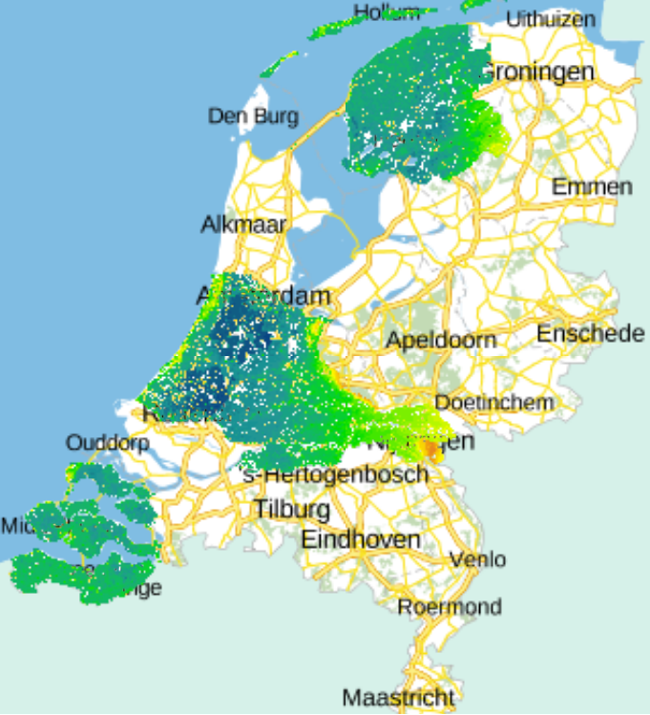
Data
AHN3
∙ Point density
∙ Multiple returns
∙ Intensity
Current extent of AHN3 (DEM)
| Introduction | | Research Area | | Data | | Method | | Results | | Discussion | | Conclusion | | Questions |

Slide 9
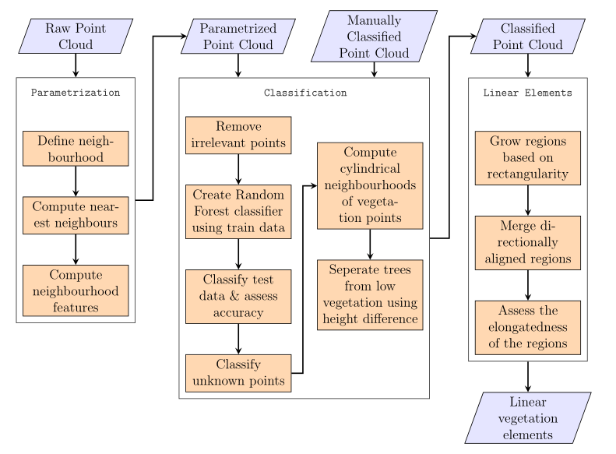
Method
| Introduction | | Research Area | | Data | | Method | | Results | | Discussion | | Conclusion | | Questions |

Slide 10
Parametrization
Define neighbourhood
∙ K-nearest neighbours
∙ Spherical
∙ Cylindrical
Basic parameters
∙ Height difference and standard deviation
∙ Radius
∙ Point density
Structure tensor parameters
| Introduction | | Research Area | | Data | | Method | | Results | | Discussion | | Conclusion | | Questions |

Slide 11
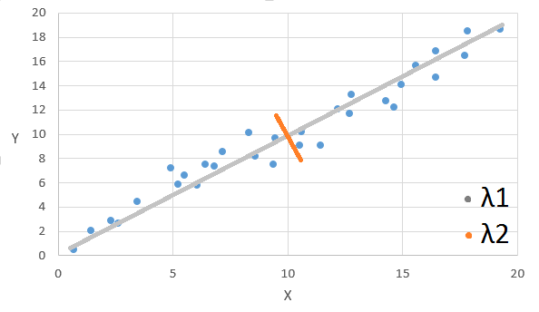
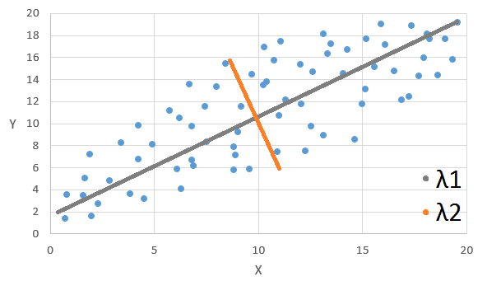
Determine the predominant
directions of a set of points
∙ Compute the eigenvectors and
eigenvalues (λ1, λ2, λ3) of the
covariance matrix
∙ Eigenvectors -> direction
∙ Eigenvalues -> magnitude
Distribution description
∙ λ1 >> λ2 > λ3 : linear
∙ λ1 ≈ λ2 > λ3 : planar
∙ λ1 ≈ λ2 ≈ λ3 : scatter
| Introduction | | Research Area | | Data | | Method | | Results | | Discussion | | Conclusion | | Questions |

Slide 12
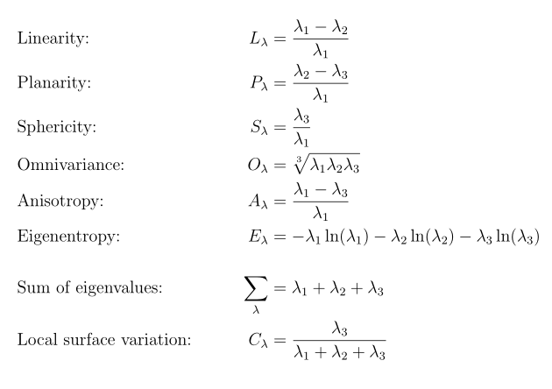
| Introduction | | Research Area | | Data | | Method | | Results | | Discussion | | Conclusion | | Questions |

Slide 13
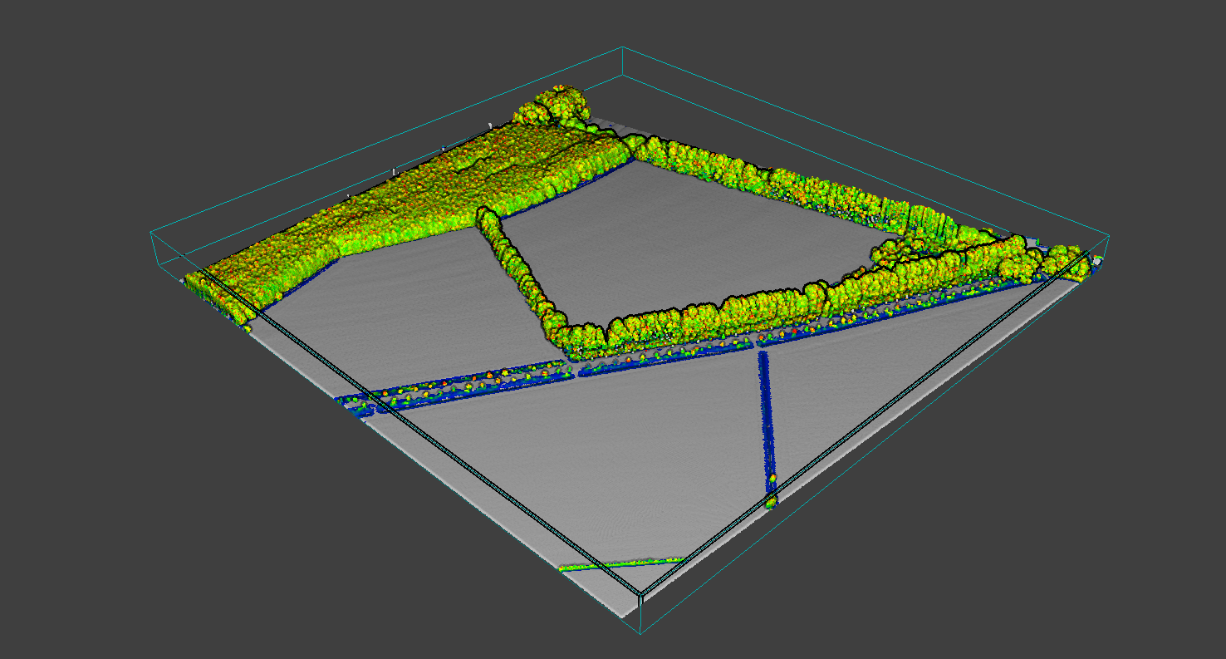
Classification
Remove irrelevant points
∙ High planarity value, P λ > 0.7
∙ Low sphericity value, S λ < 0.05
| Introduction | | Research Area | | Data | | Method | | Results | | Discussion | | Conclusion | | Questions |

Slide 14
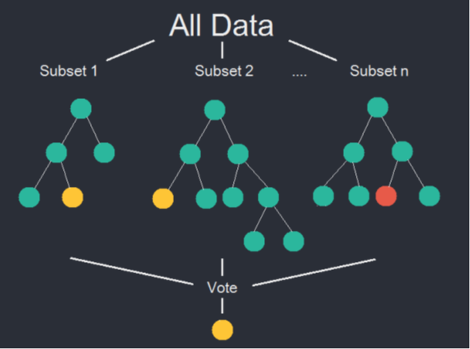
Supervised Classification
∙ Vegetation
∙ Non-vegetation
Imbalanced dataset
Balanced Random Forest
∙ Bootstrap sample minority class
∙ Random sample majority class,
size based on minority
| Introduction | | Research Area | | Data | | Method | | Results | | Discussion | | Conclusion | | Questions |

Slide 15
Accuracy assessment
∙ 10-fold cross validation
∙ Conventional metrics not useful
∙ Area under ROC-curve
∙ Matthews Correlation Coefficient
∙ Geometric mean
| Introduction | | Research Area | | Data | | Method | | Results | | Discussion | | Conclusion | | Questions |

Slide 16
Trees and low vegetation
∙ Cylindrical neighbourhood (radius of 2m)
∙ Height difference
∙ > 4m -> trees
∙ < 4m -> low vegetation
| Introduction | | Research Area | | Data | | Method | | Results | | Discussion | | Conclusion | | Questions |

Slide 17
Delineation of linear elements
Grow rectangular regions
Check for linearity
Preprocessing
∙ 2D
∙ Downsampled
| Introduction | | Research Area | | Data | | Method | | Results | | Discussion | | Conclusion | | Questions |

Slide 18
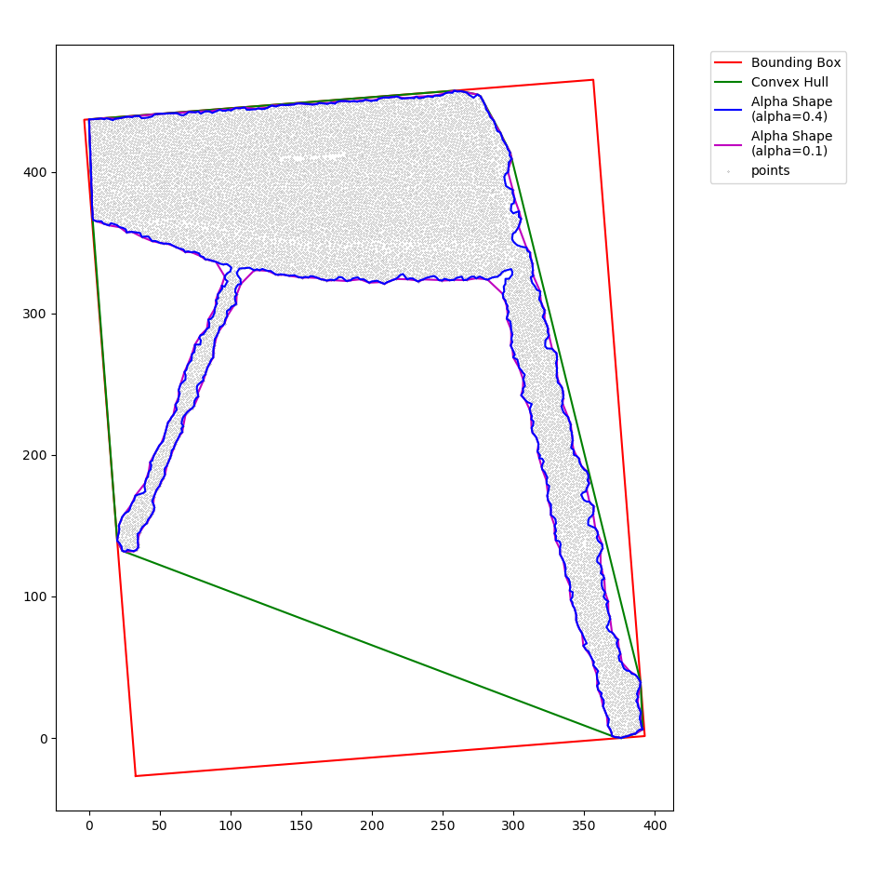
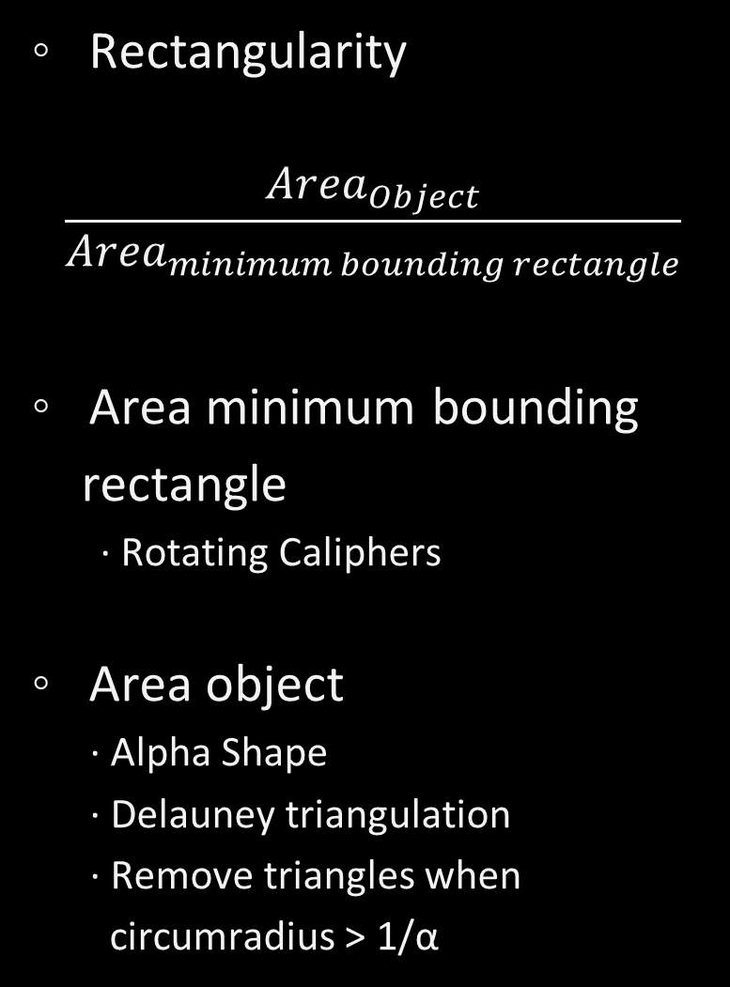
Rectangularity
$$\frac{{Area}_{Object}}{{Area}_{minimum bounding rectangle}}$$
Area minimum bounding
rectangle
∙ Rotating Caliphers
Area object
∙ Alpha Shape
∙ Delauney triangulation
∙ Remove triangles when
circumradius > 1/α
| Introduction | | Research Area | | Data | | Method | | Results | | Discussion | | Conclusion | | Questions |

Slide 19
Region growing
| Introduction | | Research Area | | Data | | Method | | Results | | Discussion | | Conclusion | | Questions |

Slide 20
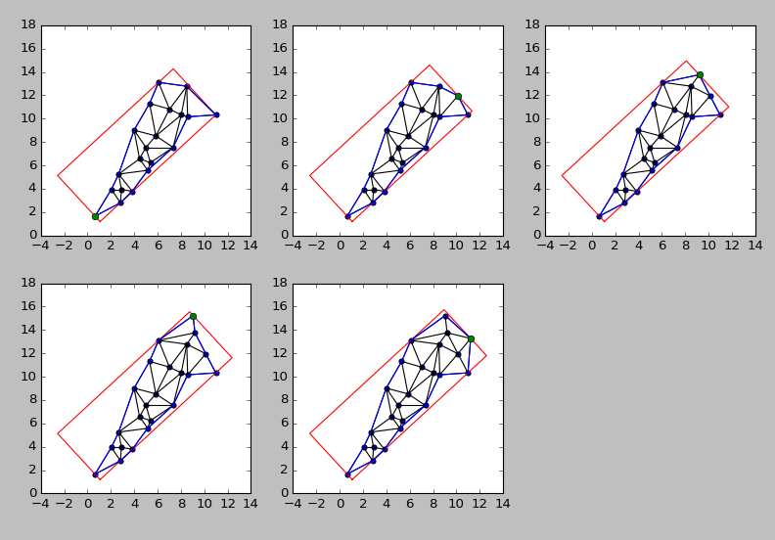
| Introduction | | Research Area | | Data | | Method | | Results | | Discussion | | Conclusion | | Questions |

Slide 21
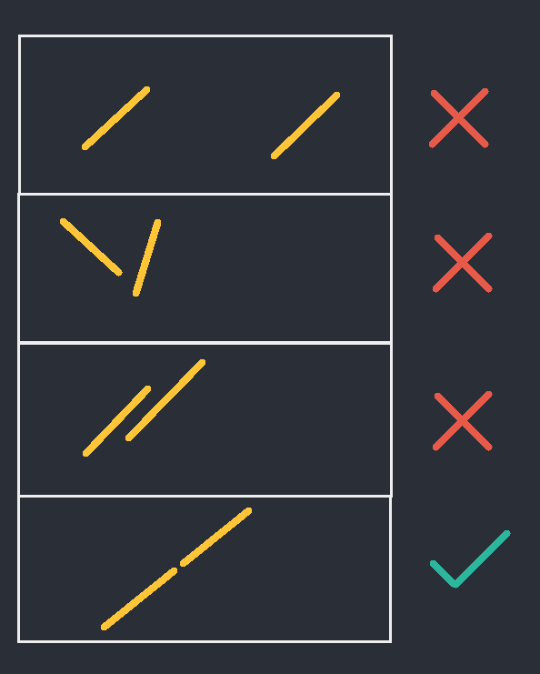
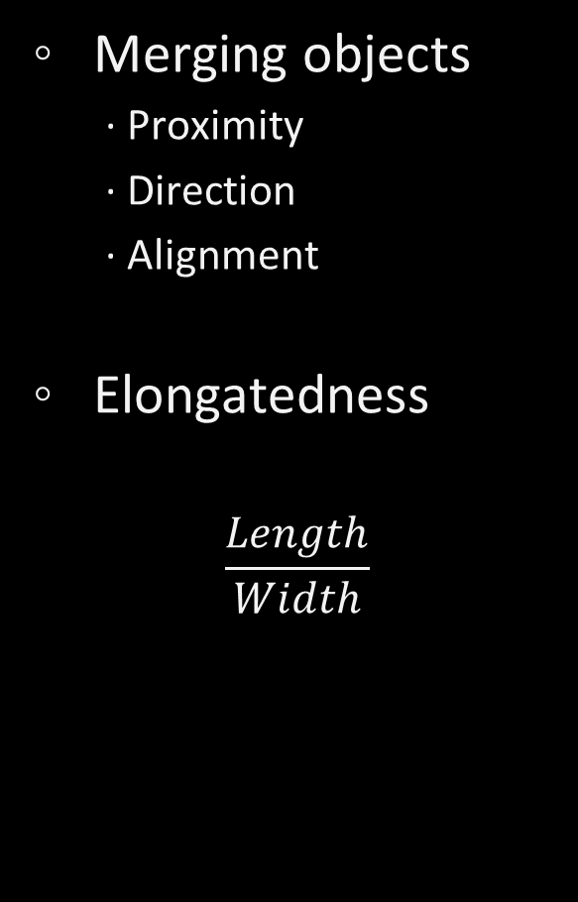
Merging objects
∙ Proximity
∙ Direction
∙ Alignment
Elongatedness
$$\frac{Length}{Width}$$
| Introduction | | Research Area | | Data | | Method | | Results | | Discussion | | Conclusion | | Questions |

Slide 22
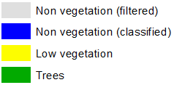
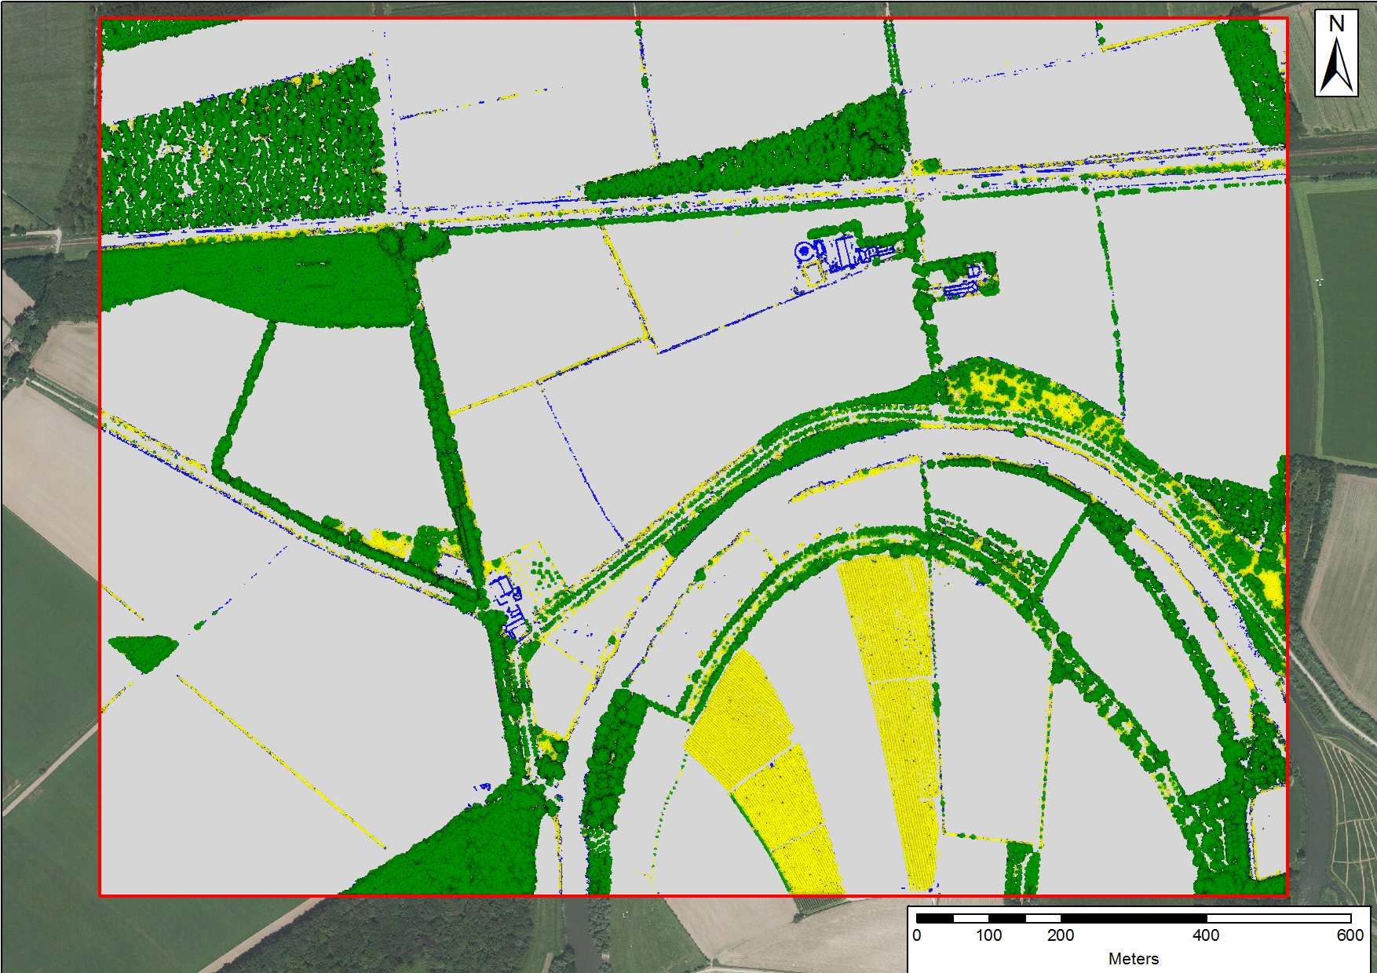
Results
Classification
| Introduction | | Research Area | | Data | | Method | | Results | | Discussion | | Conclusion | | Questions |

Slide 23
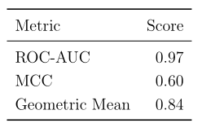
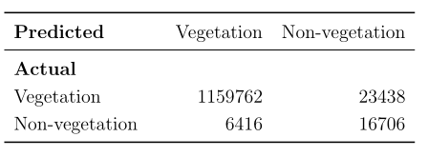
Accuracy assessment
| Introduction | | Research Area | | Data | | Method | | Results | | Discussion | | Conclusion | | Questions |

Slide 24
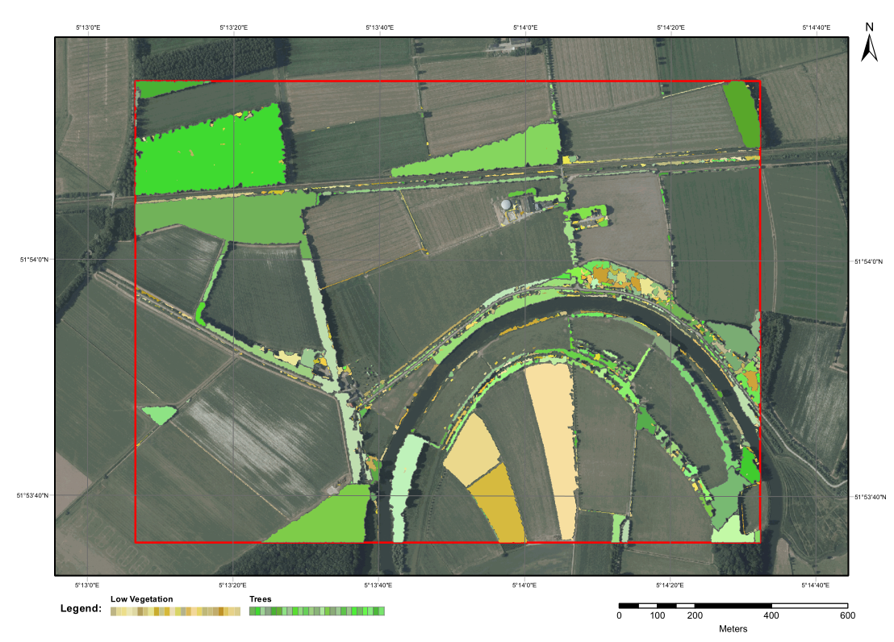
Rectangular objects
| Introduction | | Research Area | | Data | | Method | | Results | | Discussion | | Conclusion | | Questions |

Slide 25
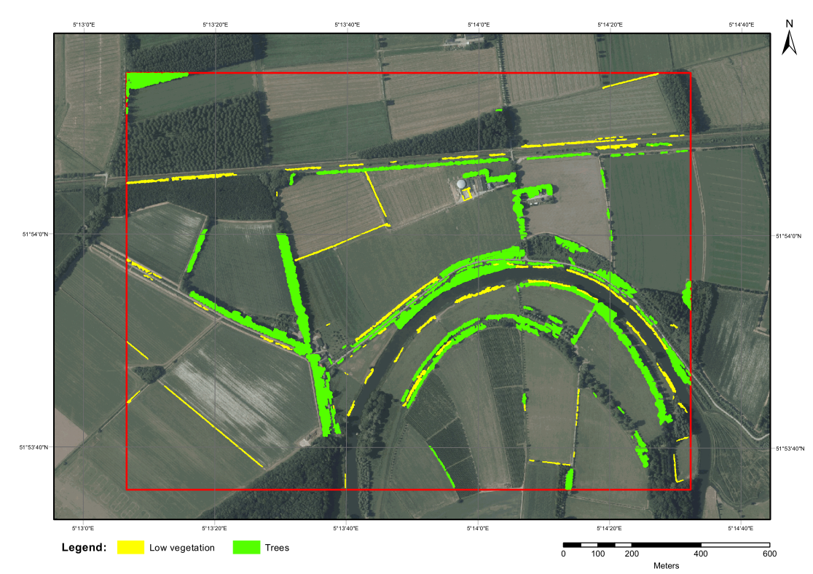
Linear objects
| Introduction | | Research Area | | Data | | Method | | Results | | Discussion | | Conclusion | | Questions |

Slide 26
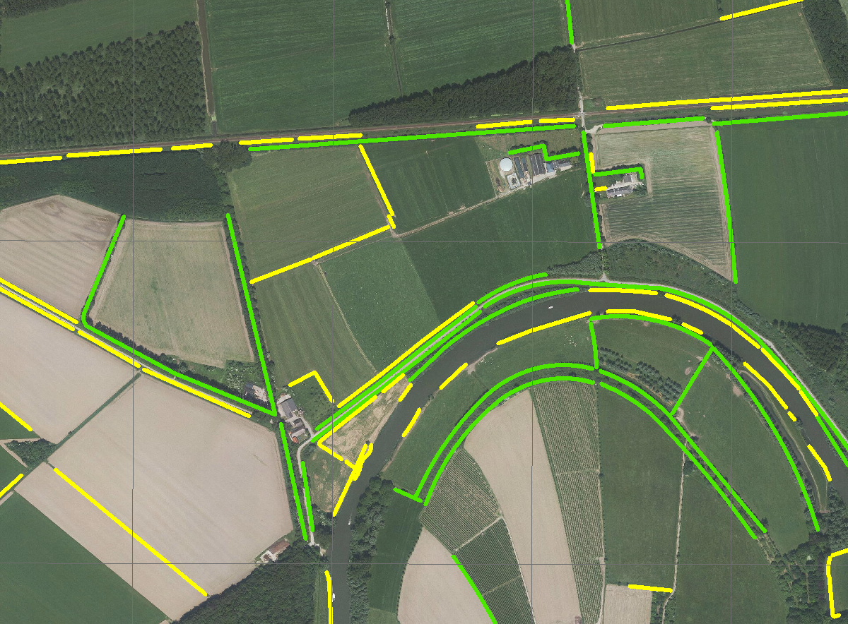
Compared with a manual delineation
| Introduction | | Research Area | | Data | | Method | | Results | | Discussion | | Conclusion | | Questions |

Slide 27
Discussion - Classification
Non-vegetation accuracy not very high
Removal of points
Possible improvements:
∙ Feature importance
∙ Different ways to handle imbalanced data
∙ Different machine learning algorithm
Purpose!
| Introduction | | Research Area | | Data | | Method | | Results | | Discussion | | Conclusion | | Questions |

Slide 28
Discussion – Delineating Linear Objects
Some inaccuracies
Main drawbacks:
∙ Computation time
∙ Merging not always correct
∙ Mixed vegetation
Successful in delineating the majority of
linear elements
| Introduction | | Research Area | | Data | | Method | | Results | | Discussion | | Conclusion | | Questions |

Slide 29
Upscalable
∙ National LiDAR datasets
∙ High performance computing paradigm
Ecological value
∙ Extra indicator for ecosystem health and biodiversity
∙ Further research
Other purposes
∙ Roads
∙ Ditches
| Introduction | | Research Area | | Data | | Method | | Results | | Discussion | | Conclusion | | Questions |

Slide 30
Questions?
Summary
Method to delineate linear vegetation elements
Generally fared well
Main drawbacks:
∙ Computation time vs accuracy
∙ Merging rules
Upscalable
Ecological value
| Introduction | | Research Area | | Data | | Method | | Results | | Discussion | | Conclusion | | Questions |

Slide 31
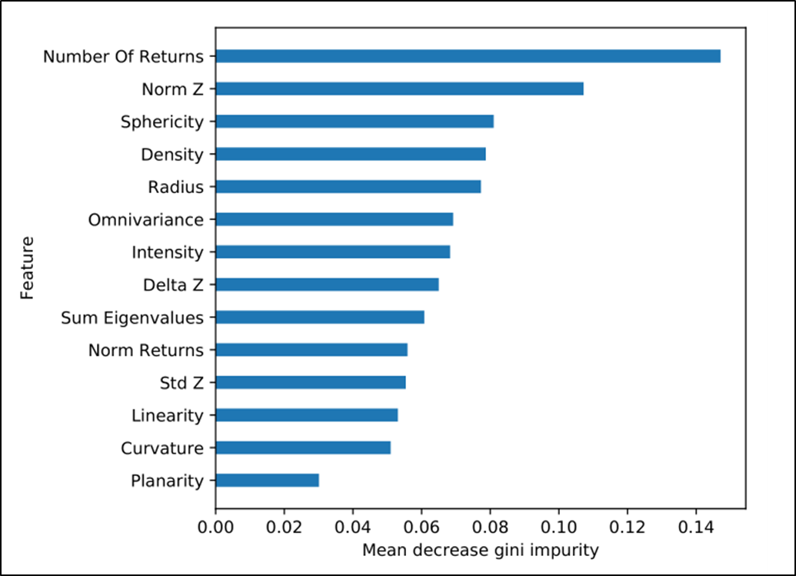
Feature Importance analysis
∙ Mean decrease impurity

